Slide 1



The smile you want.
Brought to life.
Celebrace Smile Casebook
AI-driven planning.
3D-printed precision.
Fully custom braces.
Notes:
Open with the patient benefits, not the technology.
Say: Every smile is different. With Celebrace, we start by designing the smile we are working toward, then create braces specifically for that plan.
Use this casebook to help the patient compare their main concern to real before and after examples.

Slide 2
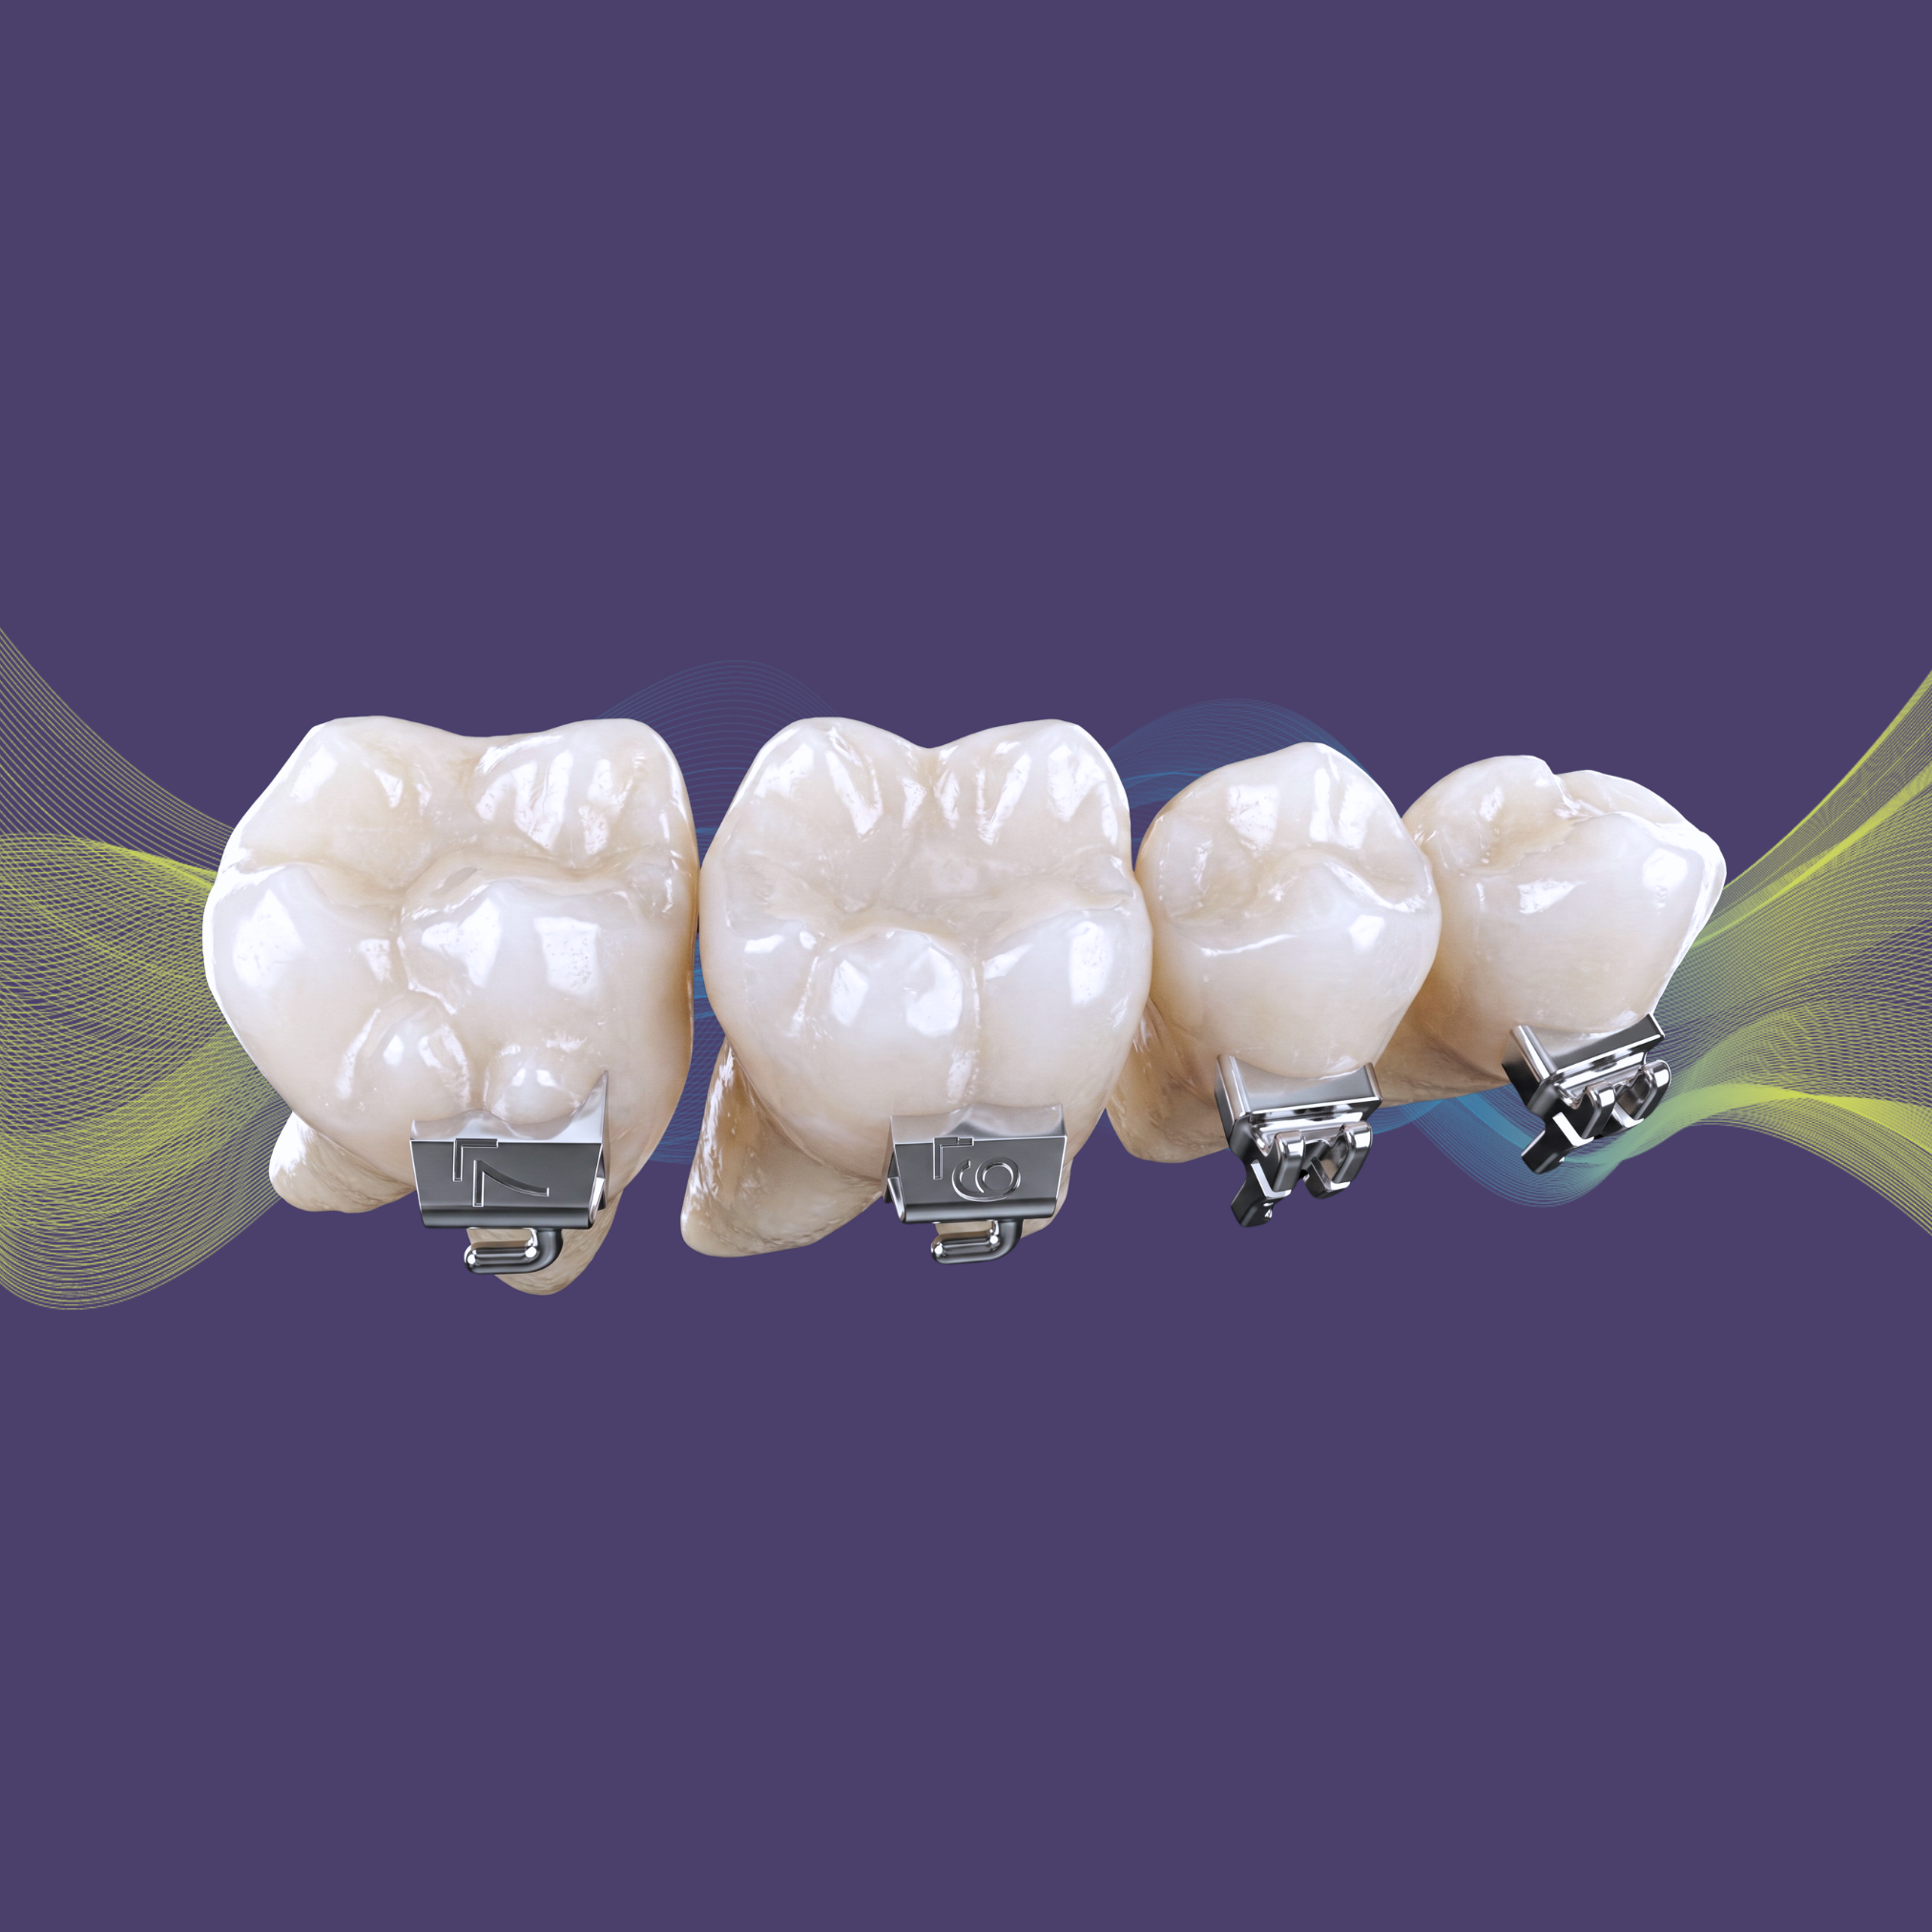

Every smile is different.
Your braces can be too.
PLANNED around your teeth and goals
CUSTOM-DESIGNED to follow your digital treatment plan
PERSONALIZED for your individual smile
Custom brackets, digitally planned for your individual smile.
Notes:
Simple explanation:
We are not choosing an average bracket and figuring everything out later.
We are planning your future smile first, then designing the braces to help us get there.
Focus on personalization, precision, efficiency, and fewer surprises.

Slide 3
Most braces are adjusted along the way.
Celebrace starts with the result in mind.
Plan your smile
1
2
Design your braceS
Guide treatment
3
Your precision treatment plan guides the braces made specifically for you.
Notes:
Use this as the core story:
Most braces start with standard parts and adjustments.
Celebrace starts with the desired outcome and creates the braces from that plan.
This helps us be more precise from the beginning instead of relying only on adjustments as treatment progresses.

Slide 4
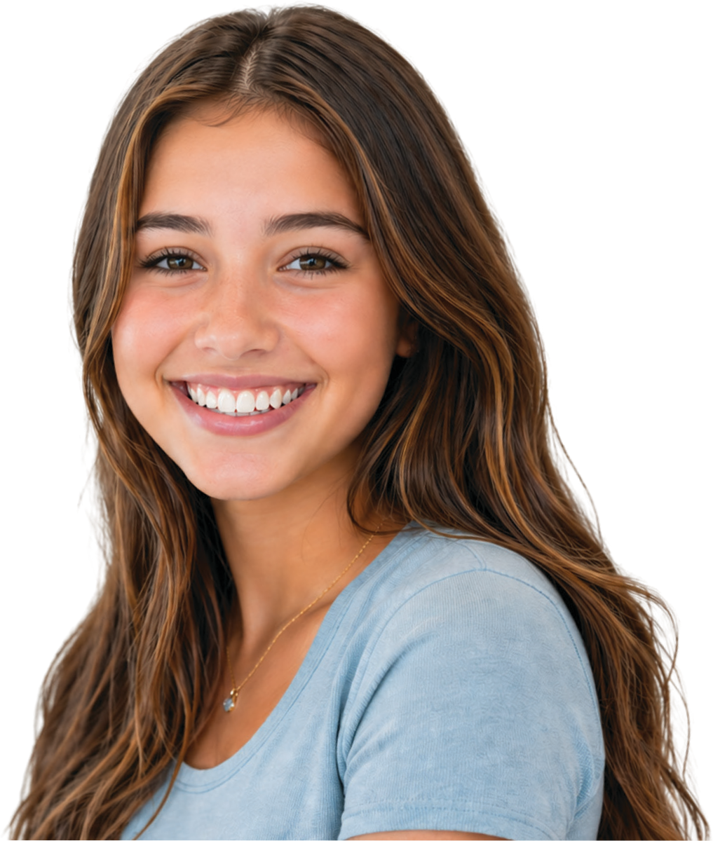
WHY CUSTOM MATTERS
01
Personalized
Designed around your individual smile.
02
Precise
Your braces follow a plan created from the start.
03
Efficient
A streamlined approach to treatment.
04
Fewer surprises
Planning helps guide progress along the way.
Ask if Celebrace is right for your smile
Notes:
This slide makes the technology meaningful to the patient. Translate every feature into a personal benefit.
Say: Celebrace is one of the ways our practice brings a more modern, personalized, and precise approach to braces.

Slide 5
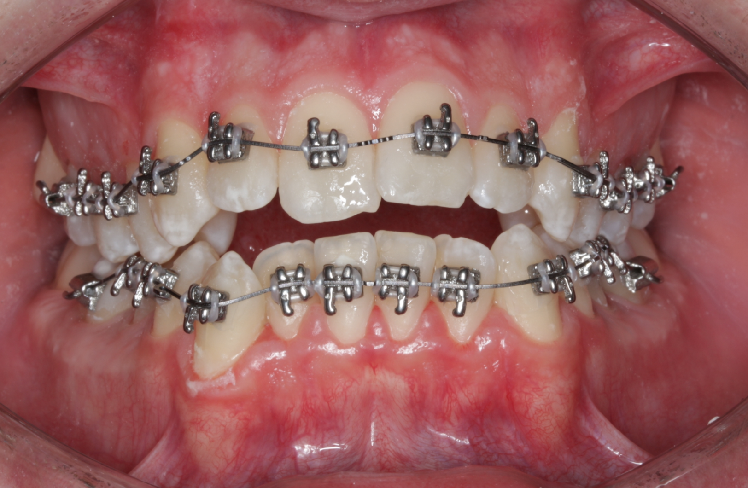
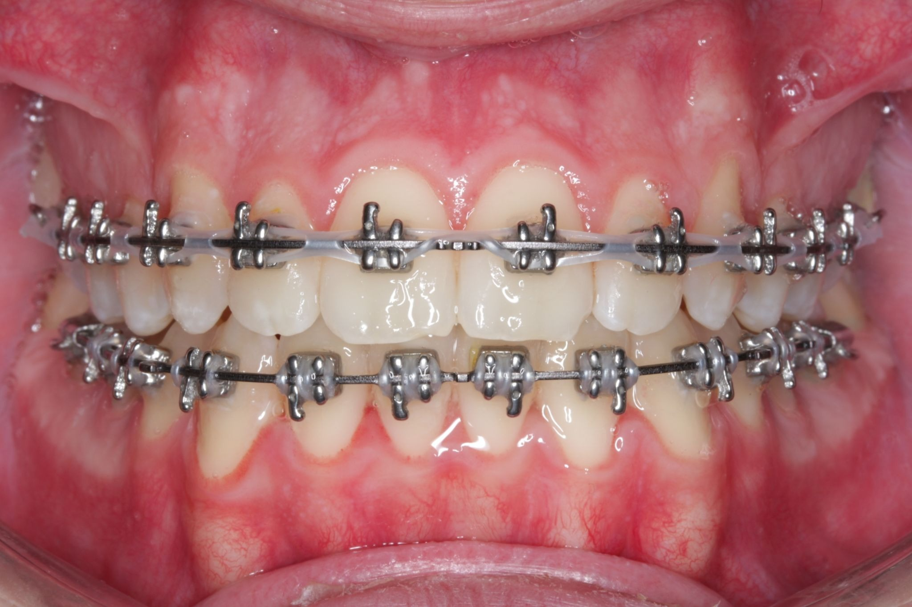
FIND A SMILE LIKE YOURS
What would you most like to change about your smile?
BEFORE
AFTER
Click on your concern:
Crowding
Deep bite
Spaces
Open bite
Overjet
Crossbite
Ask what is possible for your smile.
Notes:
This slide makes the casebook easy to navigate during a consult. Ask the patient which concern they noticed first, then jump to that section. Keep the tone supportive.

Slide 6
Crowding
When teeth do not have enough room to line up comfortably.
We start by planning where each tooth should finish, then create your braces around that plan.
‹ Return to Smile Concerns
Notes:
Talk track: Crowding is one of the most common reasons patients come to us. With Celebrace, we first plan where we want your teeth to finish, then the braces are custom-designed around that plan.

Slide 7
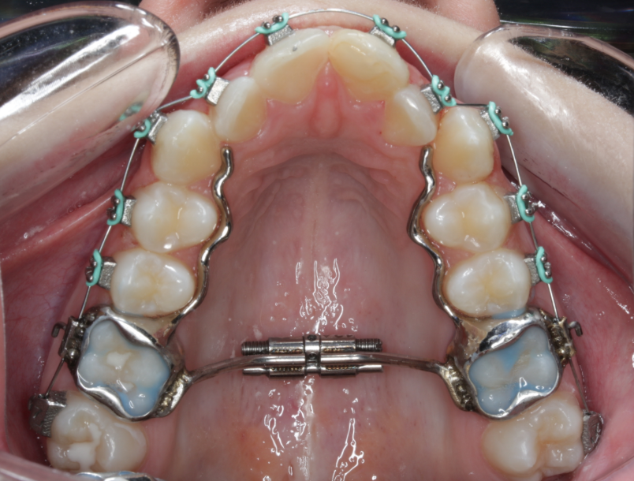
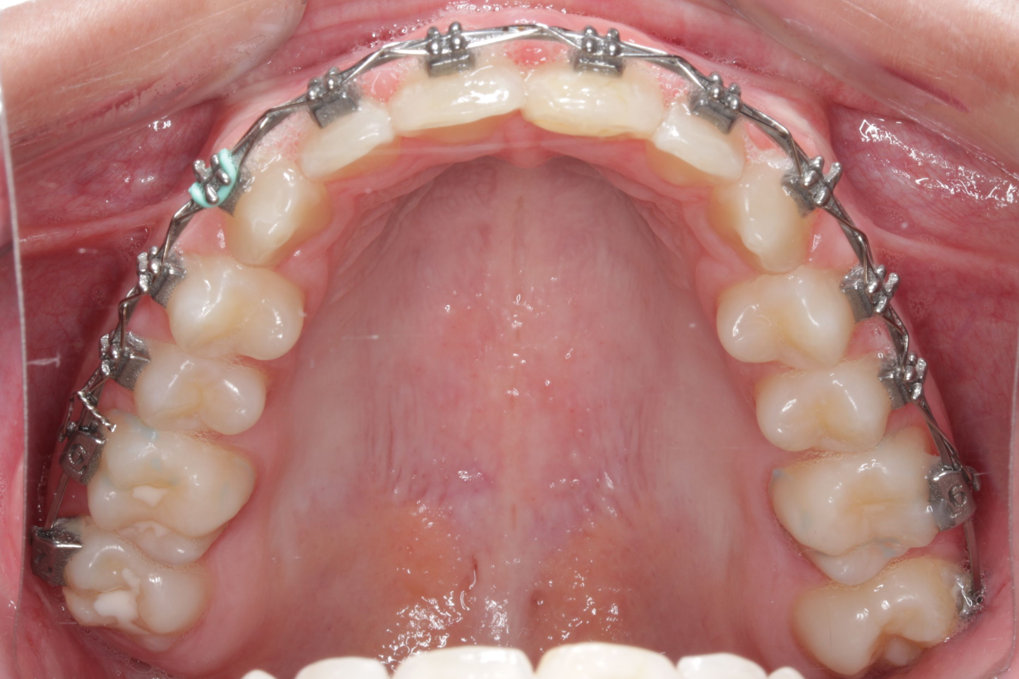
Crowding | Patient Example 1
BEFORE
AFTER
24
Weeks
Creating room for a more aligned smile.
Notes:
Talk track: Crowding is one of the most common reasons patients come to us. With Celebrace, we first plan where we want your teeth to finish, then the braces are custom-designed around that plan.

Slide 8
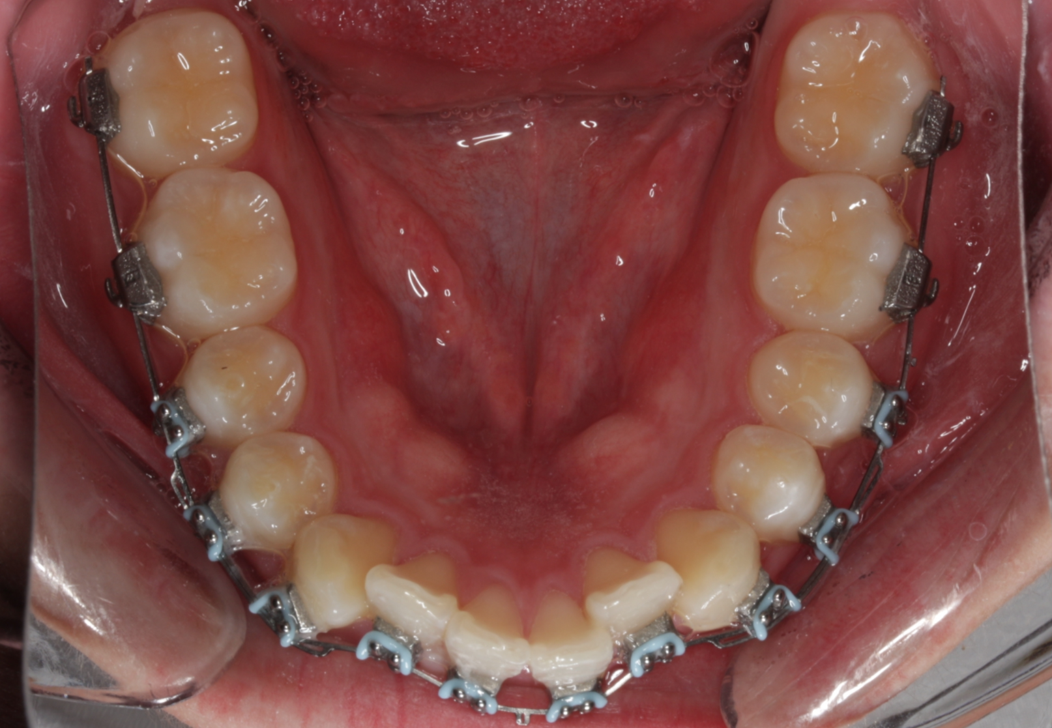
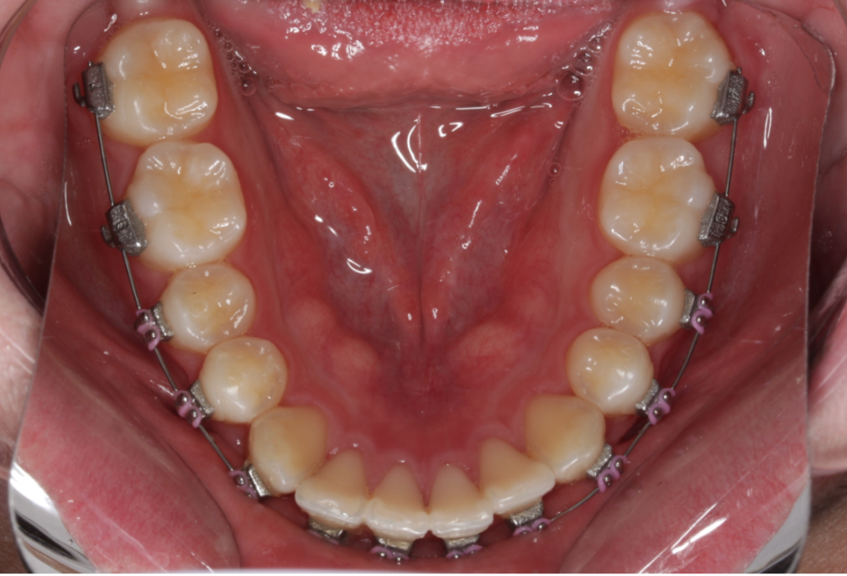
Crowding | Patient Example 2
BEFORE
AFTER
5
Weeks
Creating room for a more aligned smile.
Notes:
Talk track: Crowding is one of the most common reasons patients come to us. With Celebrace, we first plan where we want your teeth to finish, then the braces are custom-designed around that plan.

Slide 9
Spaces
When gaps between teeth are part of the smile you want to change.
We close space with the final smile in mind.
‹ Return to Smile Concerns
Notes:
Talk track: With spaces, we are thinking beyond simply closing the gaps. We are planning how the teeth should come together as part of the overall smile, then designing the braces to help us follow that plan.

Slide 10
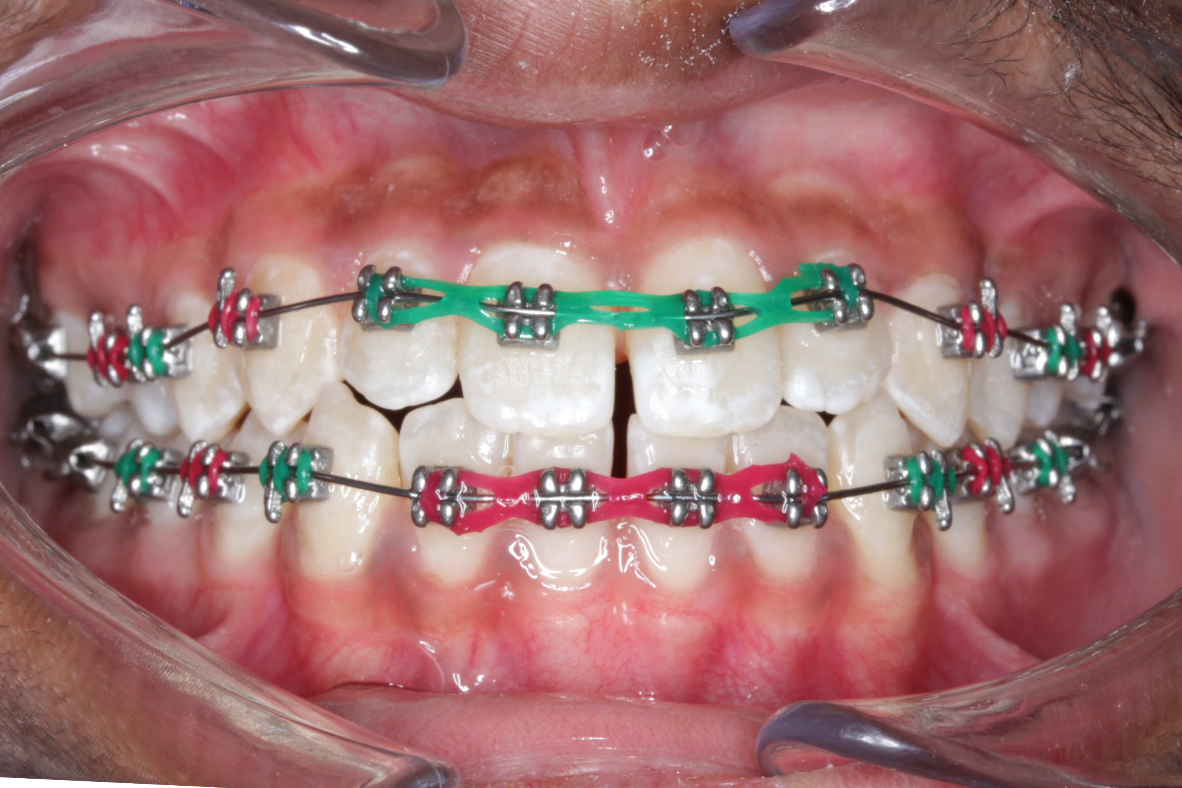
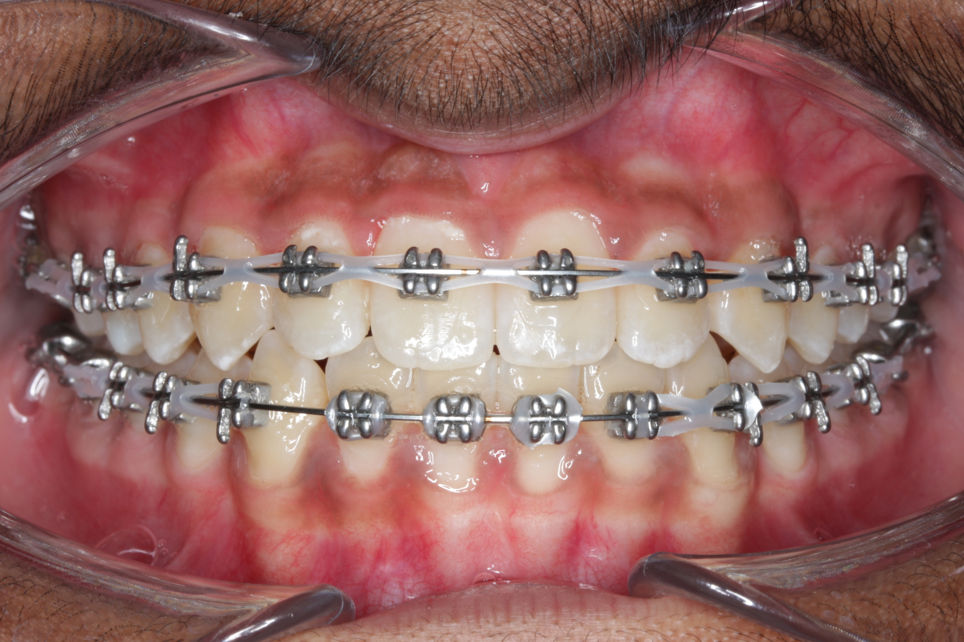
Spaces | Patient Example 1
BEFORE
AFTER
3
Weeks
Bringing teeth together with the final smile in mind.
Notes:
Talk track: With spaces, we are thinking beyond simply closing the gaps. We are planning how the teeth should come together as part of the overall smile, then designing the braces to help us follow that plan.

Slide 11
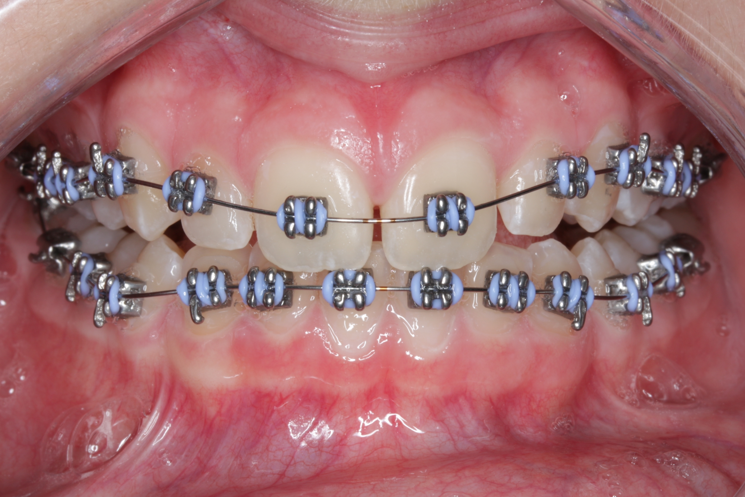
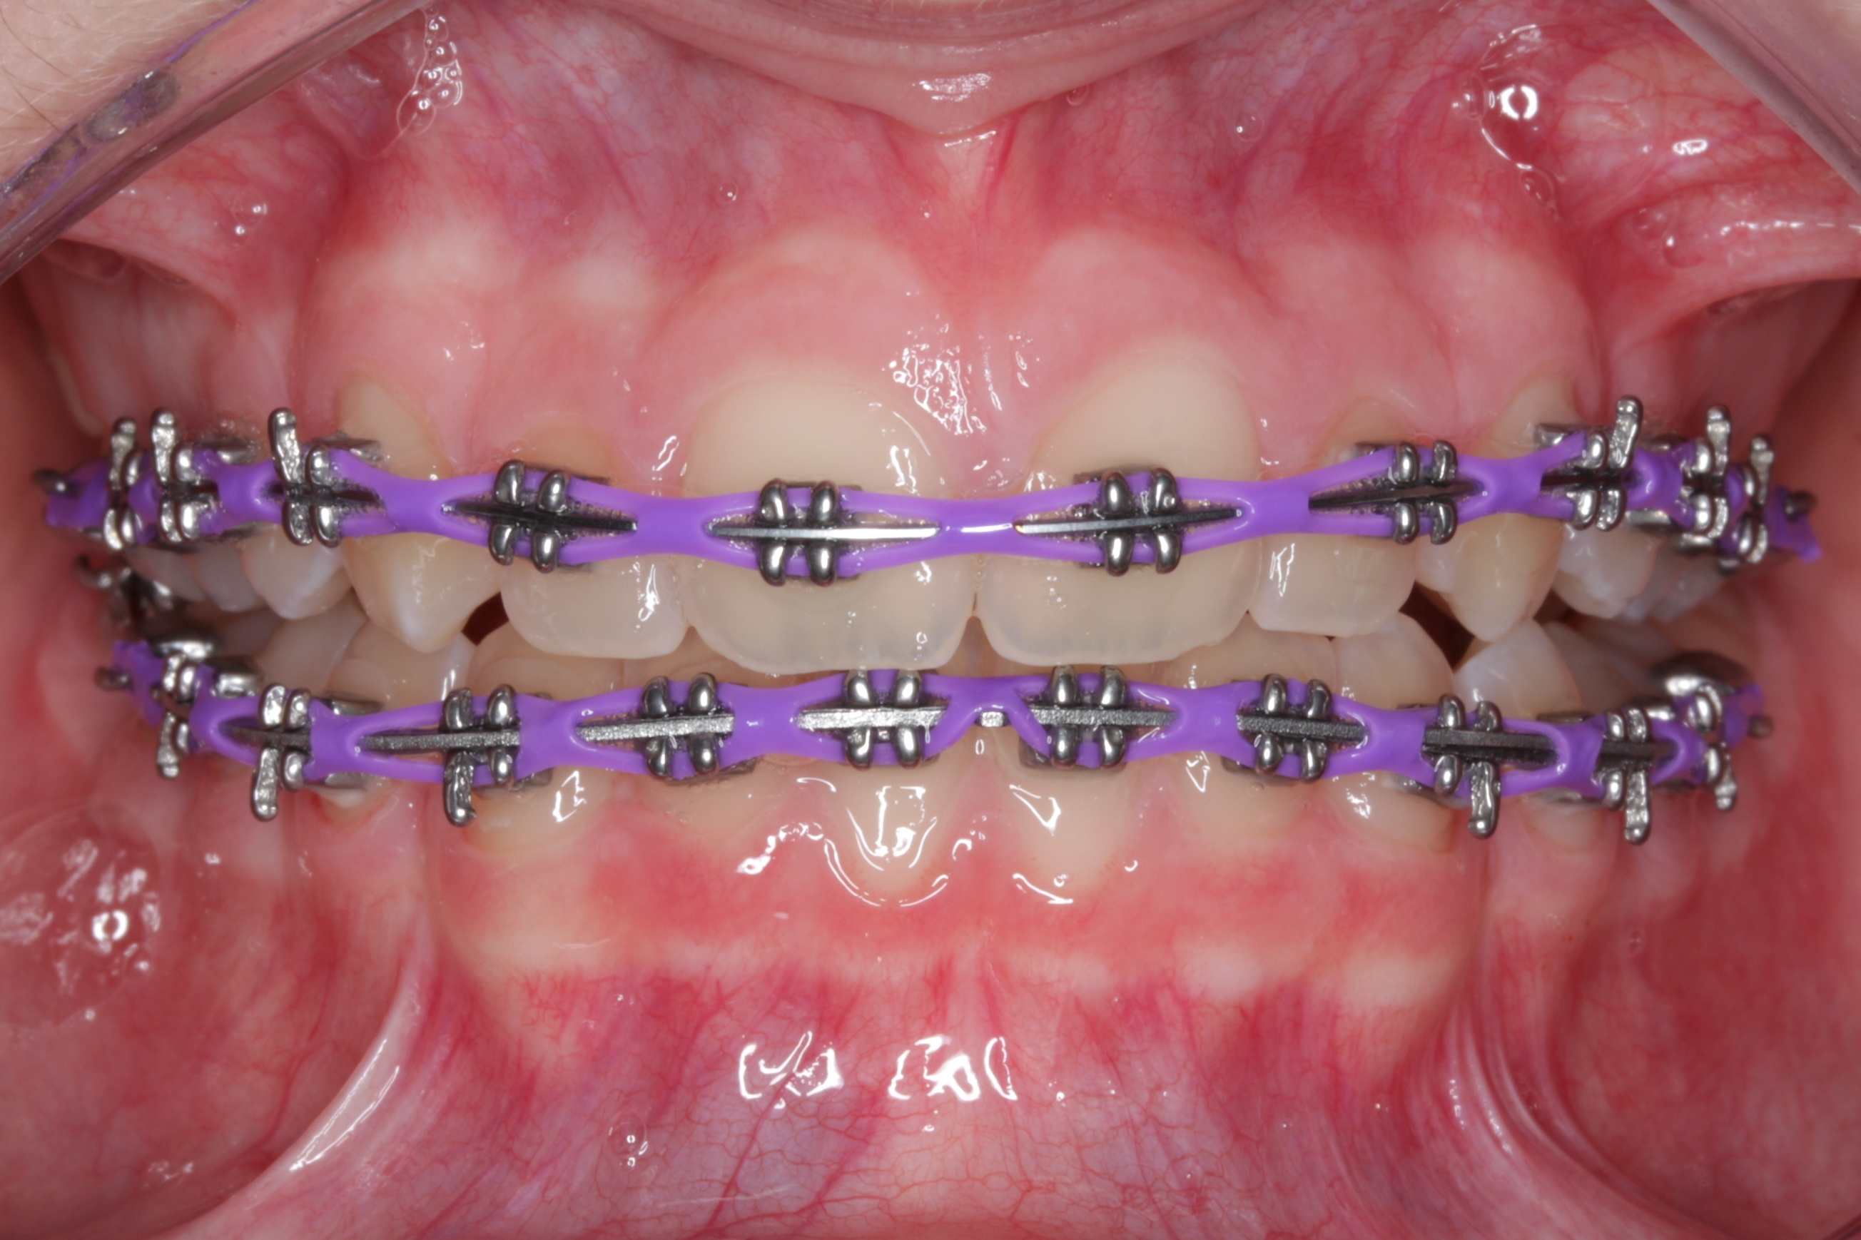
Spaces | Patient Example 2
BEFORE
AFTER
1.5
Month
Bringing teeth together with the final smile in mind.
Notes:
Talk track: With spaces, we are thinking beyond simply closing the gaps. We are planning how the teeth should come together as part of the overall smile, then designing the braces to help us follow that plan.

Slide 12
Overjet
Teeth that sit forward
When the upper front teeth sit farther forward than desired.
We plan alignment and bite relationship together.
‹ Return to Smile Concerns
Notes:
Talk track: What you may notice is that the upper teeth sit farther forward. We look at the relationship between the upper and lower teeth, not just whether individual teeth look straight.

Slide 13
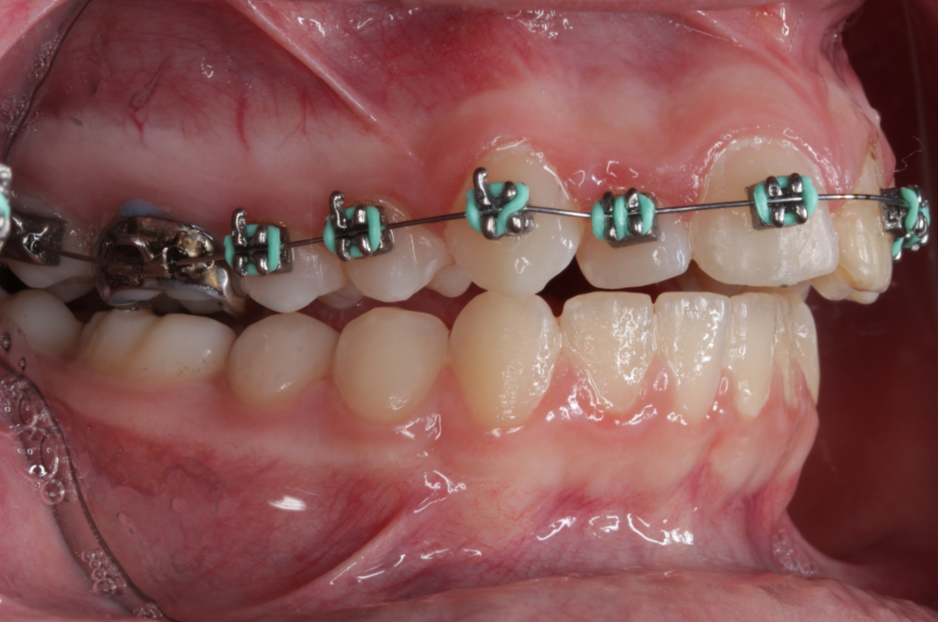
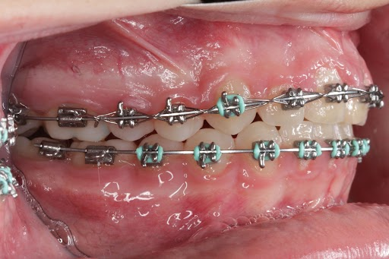
Overjet | Patient Example 1
BEFORE
AFTER
24
Weeks
Planning alignment and the relationship between upper and lower teeth.
Notes:
Talk track: What you may notice is that the upper teeth sit farther forward. We look at the relationship between the upper and lower teeth, not just whether individual teeth look straight.

Slide 14
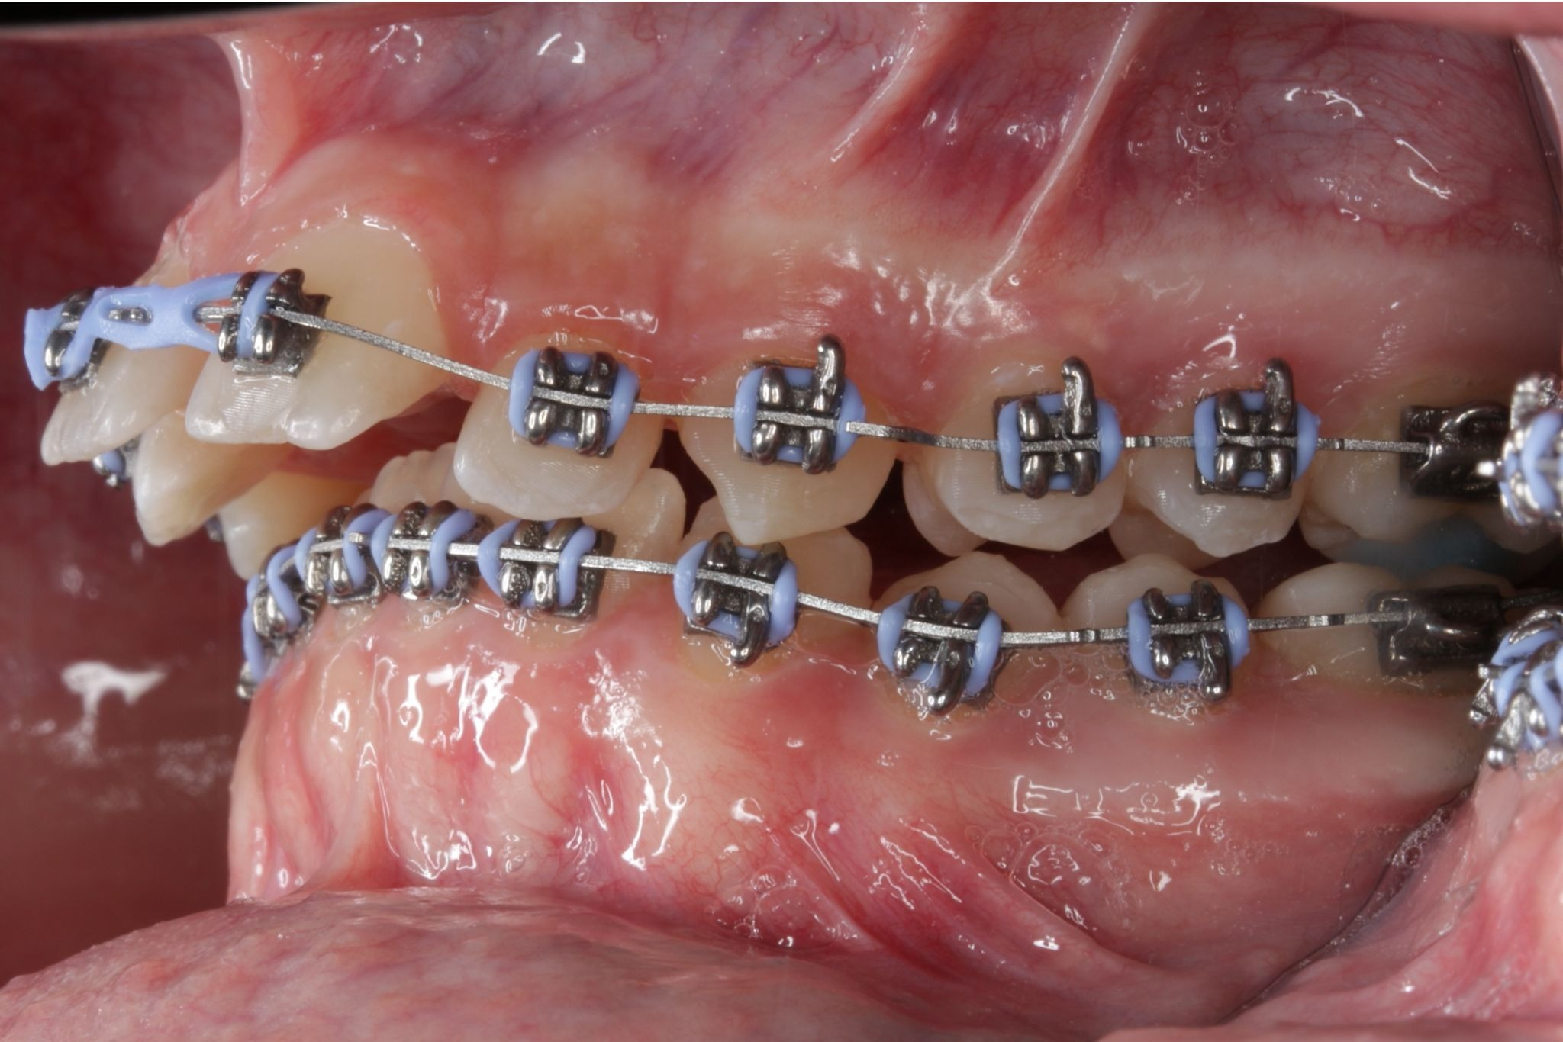
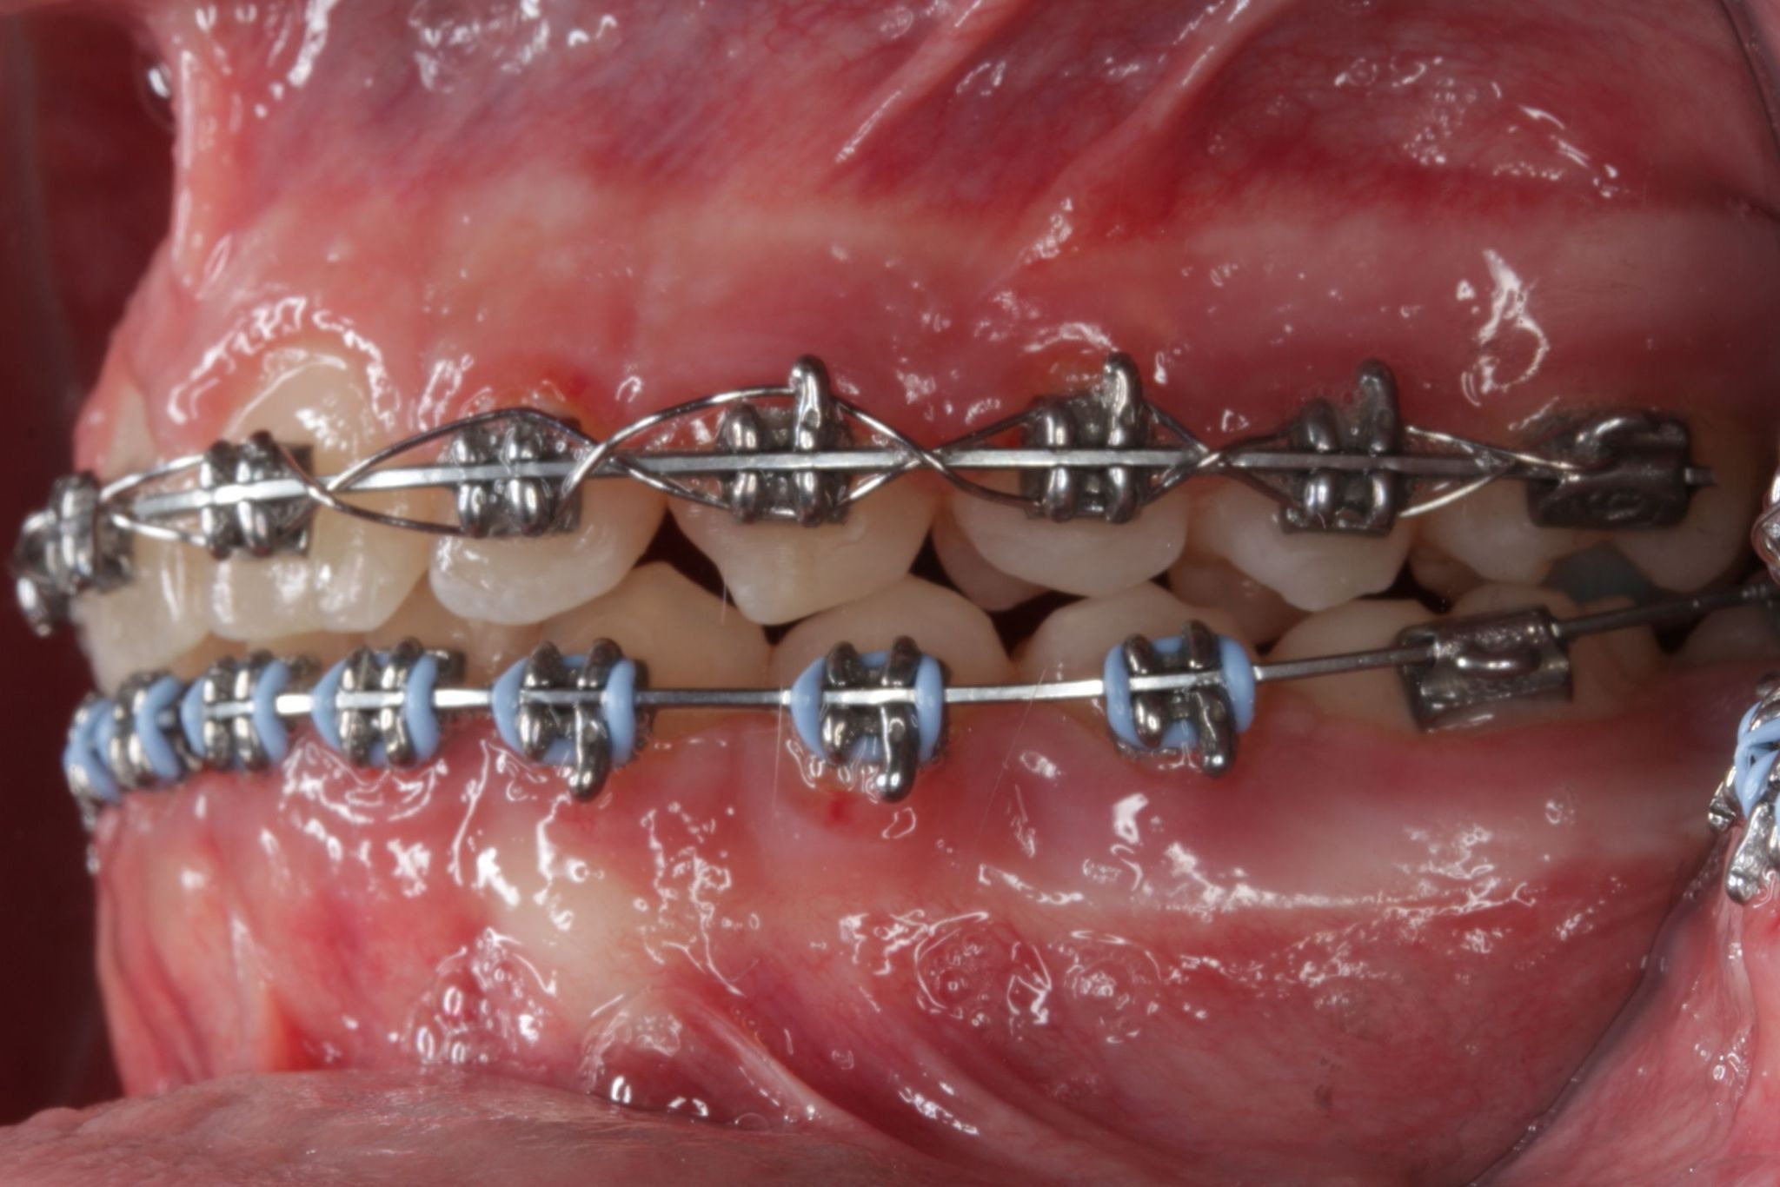
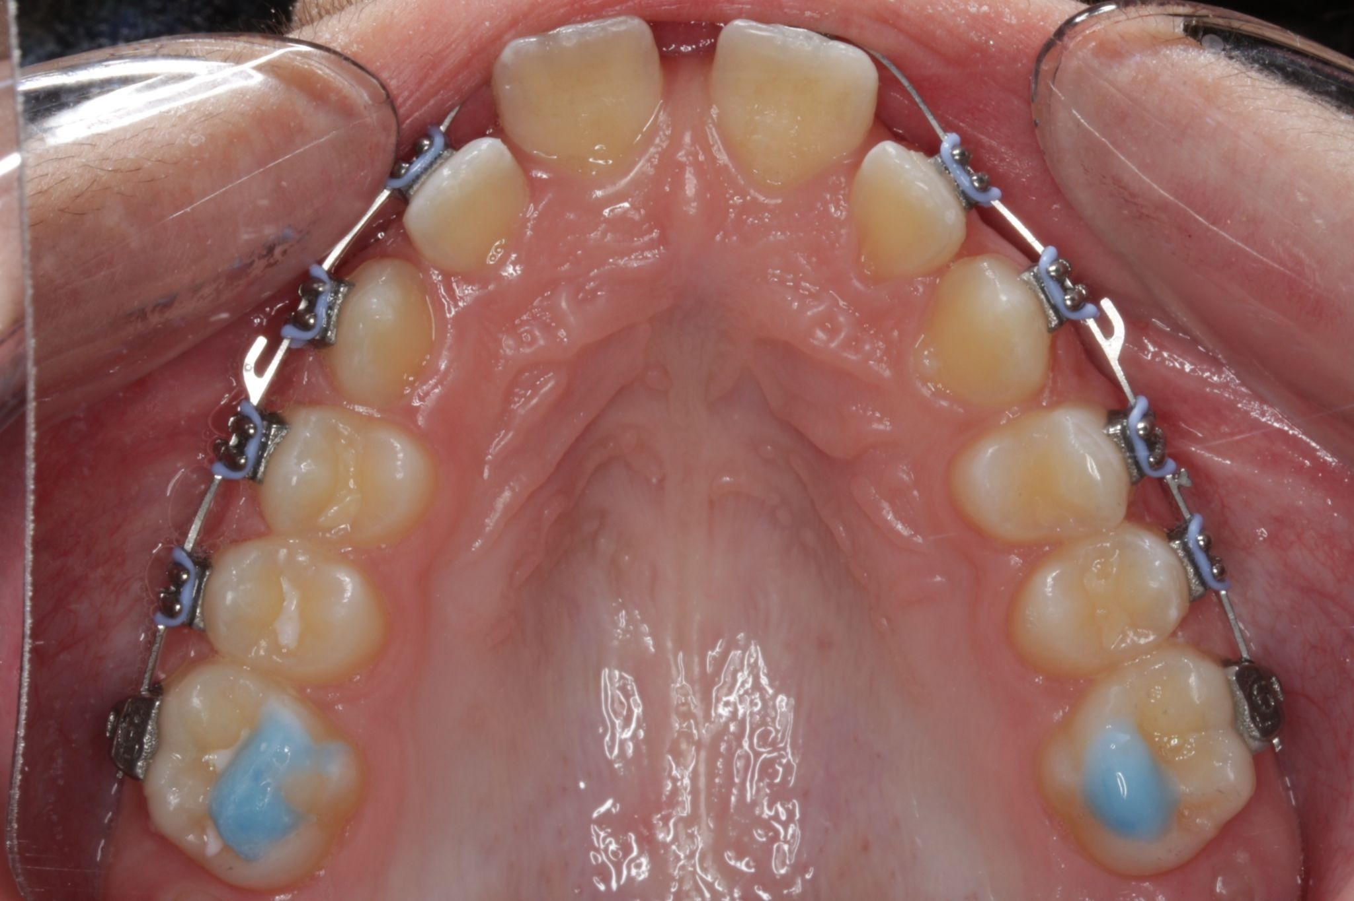
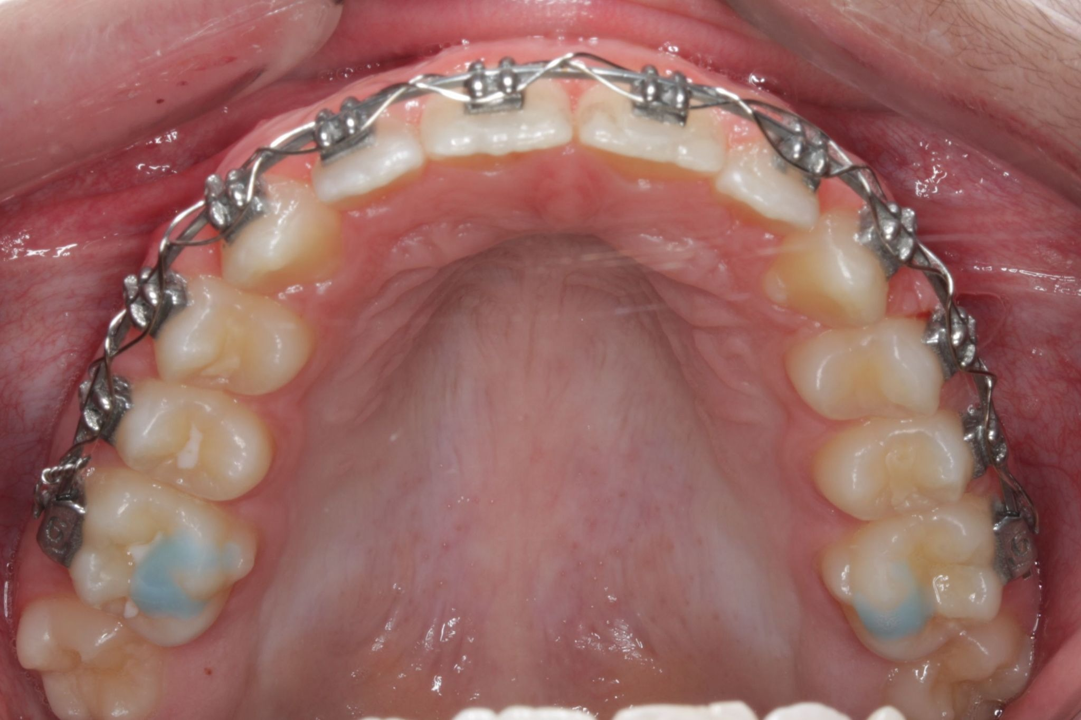
Overjet | Patient Example 2
BEFORE
AFTER
16
Weeks
Planning alignment and the relationship between upper and lower teeth.
Notes:
Talk track: What you may notice is that the upper teeth sit farther forward. We look at the relationship between the upper and lower teeth, not just whether individual teeth look straight.

Slide 15
Deep Bite
When the upper teeth cover more of the lower teeth than we want.
We plan how the teeth align and come together.
‹ Return to Smile Concerns
Notes:
Talk track: In a deep bite, we are looking at how much the upper teeth cover the lower teeth. The goal is to plan both tooth alignment and how the bite comes together as treatment progresses.

Slide 16
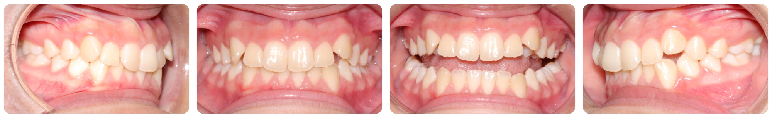
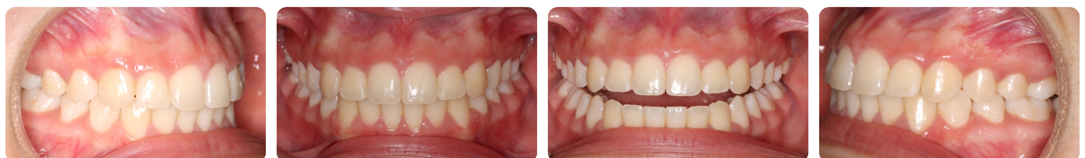
Deep Bite | Patient Example 1
BEFORE
AFTER
Treatment Time: 11 months
Planning how the teeth align and come together.
Notes:
Talk track: In a deep bite, we are looking at how much the upper teeth cover the lower teeth. The goal is to plan both tooth alignment and how the bite comes together as treatment progresses.

Slide 17
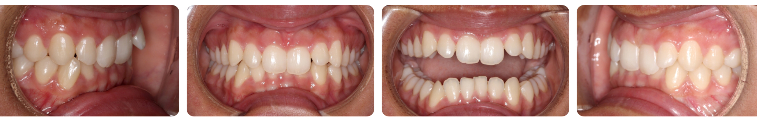
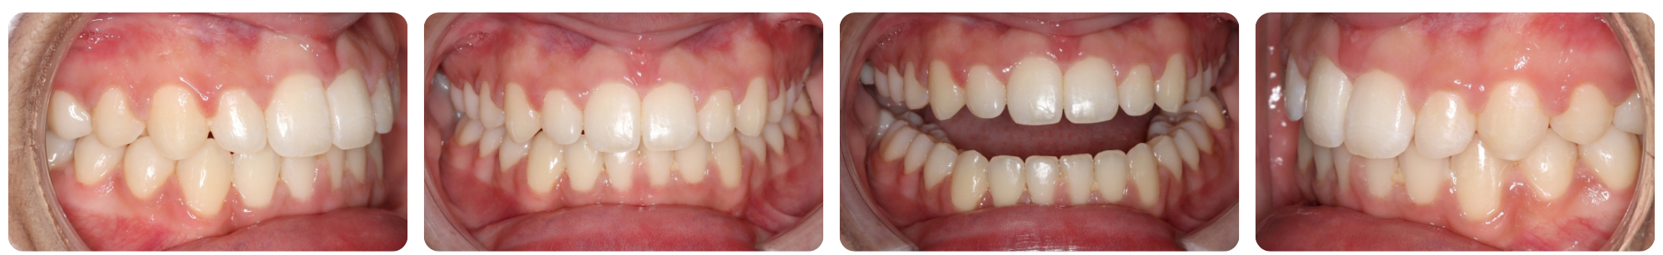
Deep Bite | Patient Example 2
BEFORE
AFTER
Treatment Time: 10 months
Planning how the teeth align and come together.
Notes:
Talk track: In a deep bite, we are looking at how much the upper teeth cover the lower teeth. The goal is to plan both tooth alignment and how the bite comes together as treatment progresses.

Slide 18
Open Bite
When some upper and lower teeth do not meet when you bite.
We guide teeth toward better contact and balance.
‹ Return to Smile Concerns
Notes:
Talk track: An open bite is a great example of why we plan the entire result first. Your doctor is considering where the teeth need to move and how they should ultimately come together.

Slide 19
Open Bite | Patient Example 1
BEFORE – Front
AFTER – Front
5
Months
Guiding teeth toward better contact and alignment.
Notes:
Talk track: An open bite is a great example of why we plan the entire result first. Your doctor is considering where the teeth need to move and how they should ultimately come together.

Slide 20
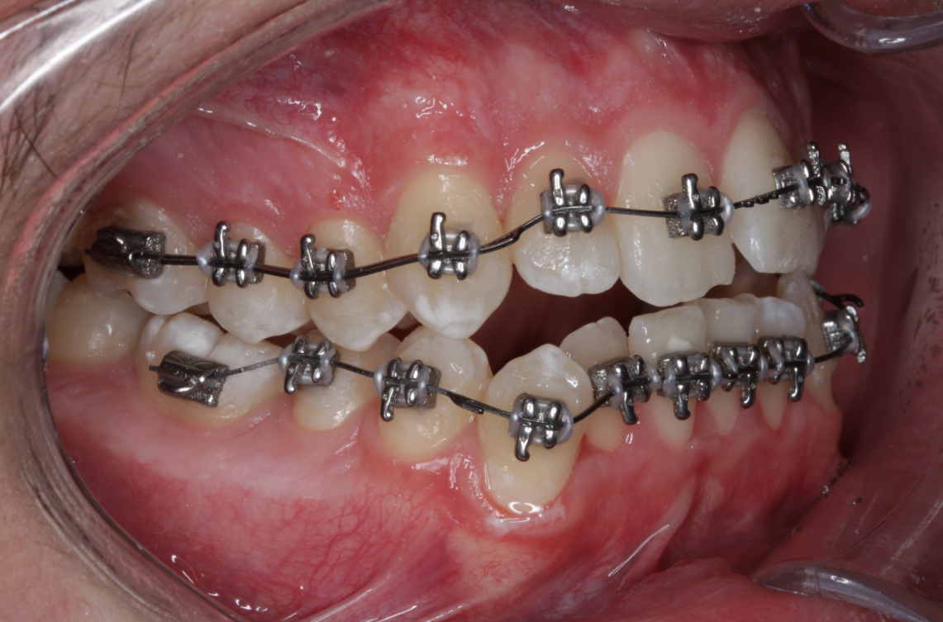
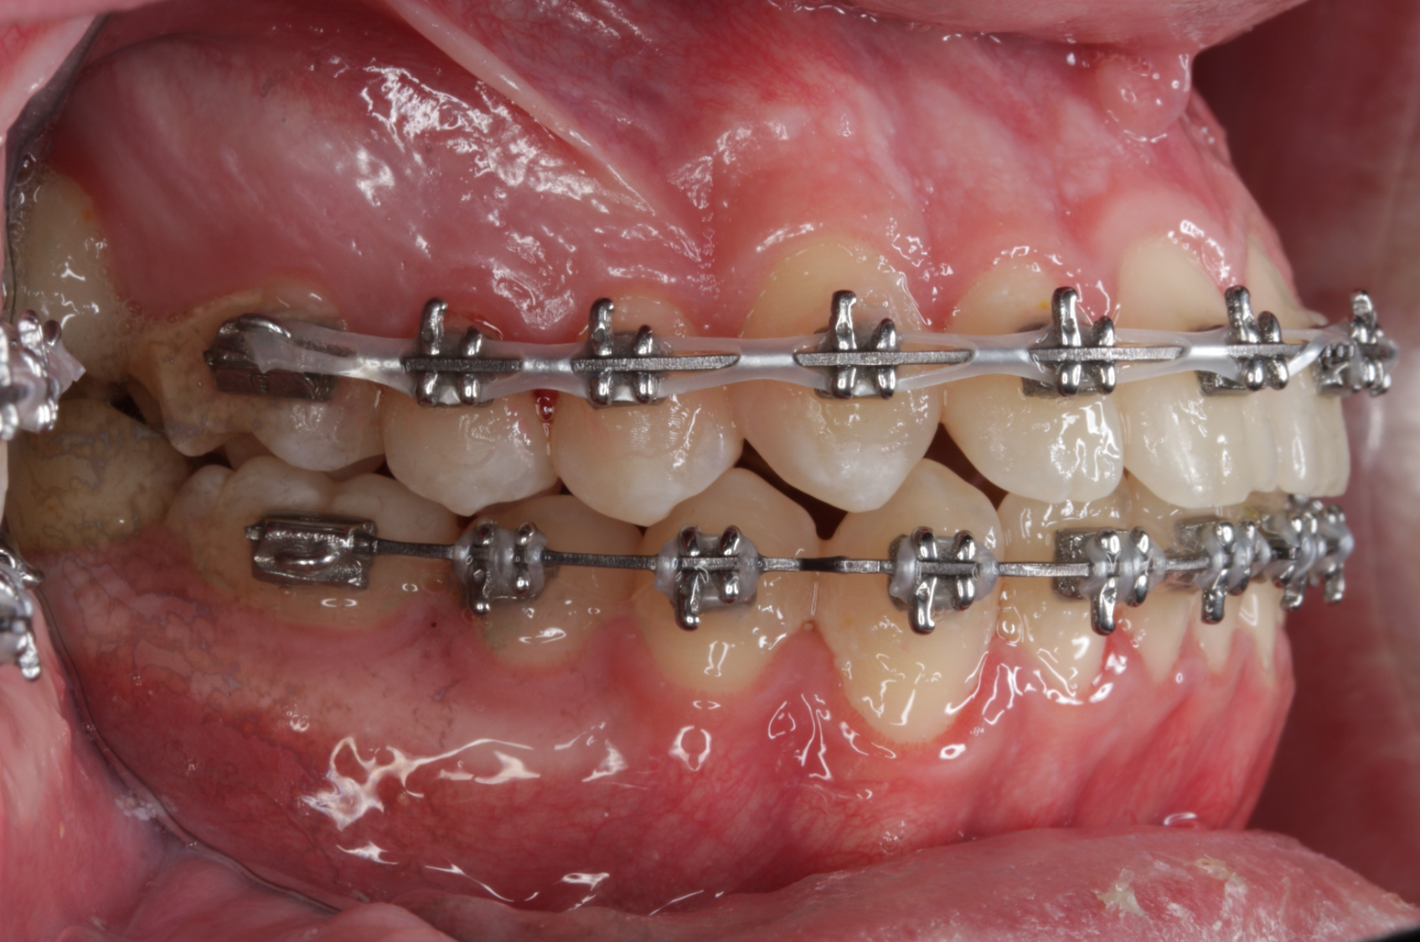
Open Bite | Patient Example 1
BEFORE – Side
AFTER – Side
5
Months
Guiding teeth toward better contact and alignment.
Notes:
Talk track: An open bite is a great example of why we plan the entire result first. Your doctor is considering where the teeth need to move and how they should ultimately come together.

Slide 21
Crossbite
When some upper and lower teeth meet in the opposite relationship from where they should.
We plan a better relationship between upper and lower teeth.
‹ Return to Smile Concerns
Notes:
Talk track: With crossbite, your doctor is looking at how the upper and lower teeth meet. The plan helps guide not only tooth alignment, but also the relationship of the bite.

Slide 22
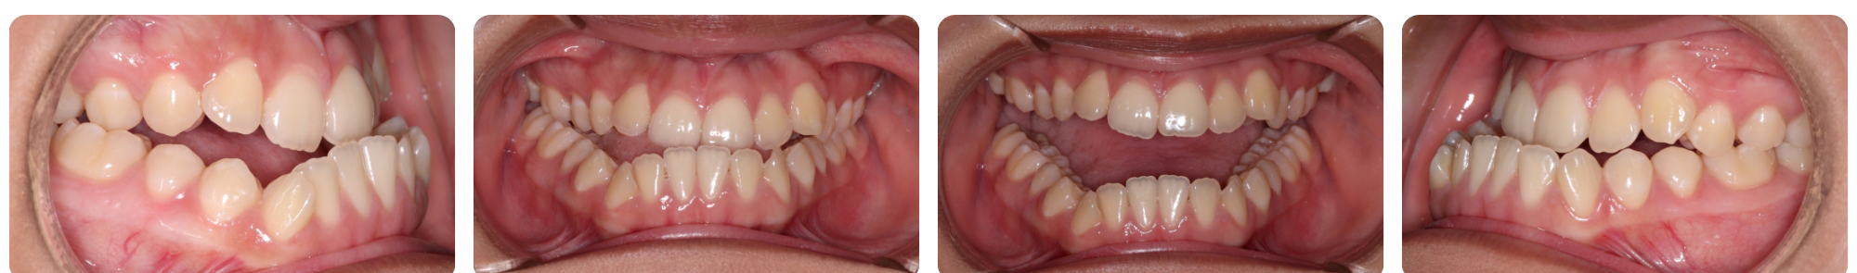
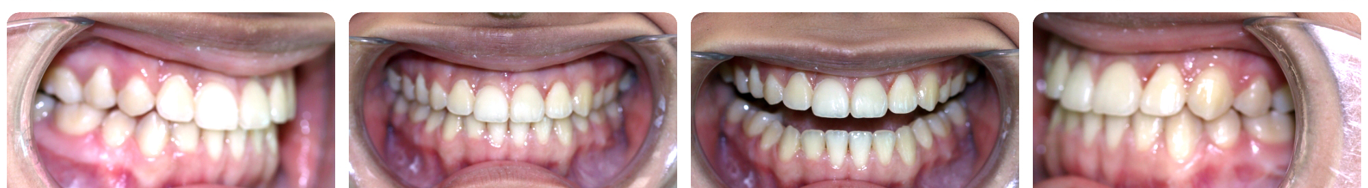
Crossbite | Patient Example 1
BEFORE
AFTER
Treatment Time: 1 year, 8 months
Planning a better relationship between the upper and lower teeth.
Notes:
Talk track: With crossbite, your doctor is looking at how the upper and lower teeth meet. The plan helps guide not only tooth alignment, but also the relationship of the bite.

Slide 23
LET’S TALK ABOUT YOUR SMILE
What matters most to you?
☐ How my smile looks
☐ How my teeth fit together
☐ Treatment efficiency
☐ Fewer appointments
☐ Knowing the plan from the start
Could Celebrace be right for my smile?
Notes:
What matters most to you about treatment?
Your answer helps us understand what you want from the experience and from your final smile.
Celebrace starts with a digital plan and custom braces designed around that plan, so let’s talk about whether it may be right for you.
After they identify one or two priorities, the TC should ask:
“Tell me a little more about why that matters most to you.”

Slide 24
LET’S BRING YOUR FUTURE SMILE TO LIFE
See your plan.
Understand your options.
Choose your next step.
Notes:
Based on what matters most to you, the next step is to review what your doctor is recommending for your smile, answer any remaining questions, and talk through what it would look like to begin.
You do not have to understand every detail today. Our job is to make the plan clear, help you feel confident, and make sure the treatment feels right for you.
Let’s talk about your next steps.

